Slide 1
Onboarding in OMS
Getting the job done with Azure Automation

Slide 2

Consultant
stijn.callebaut@inovativ.be
@stijnca
Notes:
Stijn Callebaut
Consultant at Inovativ,
Specializing in System Center Service Manager and Azure (Automation) with a love for PowerShell

Slide 3
agenda
Position Azure Automation within OMS
Provide an overview of Azure Automation capabilities
Runbooks and Assets
Security
Configuration management

Slide 4
Azure Automation!?
Is part of something larger, called OMS
Used to automate processes
Enables configuration management
Talks to any cloud or on-premises infrastructure

Slide 5
What makes up Azure Automation?
Runbooks
(scripts, workflows and graphical)
Assets
(Modules, variables, credentials, certificates, connections and schedules)
Hybrid workers
Jobs
Configurations
(DSC Configurations, DSC Node configurations and DSC nodes)
= Automation Account

Slide 6
Demo: Automation resources
Notes:
Create an automation Account
Logon into the portal
Click New
Select Management > Automation
Provide the needed info
Name
Resource group
Subscription
Region
Account options (yes to demo runbooks)
Explain the Automation resources available
Go over each tile
Runbooks (Workflow, script, graphical)
Jobs
Worker groups
Assets (Credentials, Connections, Certificates, schedules, variables, modules)
DSC Configurations
DSC Node Configuations
DSC Nodes
Monitoring
Source Control
Runbooks (Provide a little bit more info on runbooks)
Click the runbooks tile
Describe the runbook
Click Add a runbook
Discuss the options
Close the pane and go back
Click browse gallery (takes you to technet gallery)
Select a runbook, discuss what you see
Close the pane
Make the entry to the authoring slide

Slide 7
Runbook authoring
Azure portal
Text editor
Graphical editor
PowerShell ISE
Visual studio
Visual studio code
….

Slide 8
Interaction
How can we interact with Azure Automation runbooks?
Via the portal (start, stop action buttons)
Using the Azure automation PowerShell module
Azure Resource Manager (ARM) API
Azure automation Schedules
Azure Alerts
Another runbook
Webhooks
Notes:
Azure alerts is currently in preview and needs to be enabled.

Slide 9
Demo: Interaction with runbooks
Notes:
Portal authoring experience
Open a Graphical runbook and discuss
Refer to the previous demo for the text authoring
Open the runbook stop VM with tag
Edit the runbook
Select test pane
Click start
Go back to the previous pane
Click the schedule icon
Discuss
Go back
Click the webhook icon
Discuss
Copy the webhook url
Open powerShell ISE
PowerShell - webhook
Open the tab – INvoke-FromWebhook
Copy\paste the url
Execute
Go back to the portal and show
PowerShell + Azure automation add-on
Log into Azure
Show the runbook sync
Modify
Sync to cloud

Slide 10
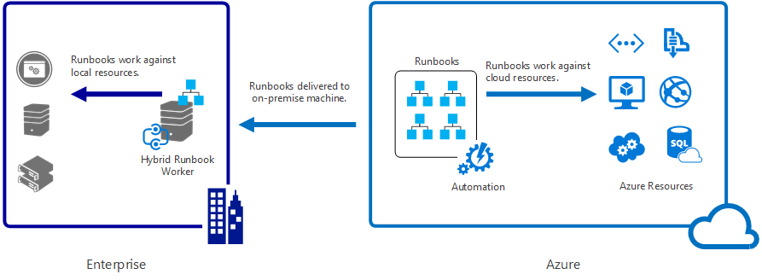
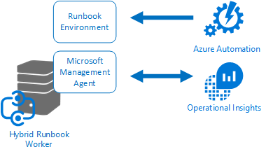
Going Hybrid
Notes:
https://azure.microsoft.com/en-us/documentation/articles/automation-hybrid-runbook-worker/
https://azure.microsoft.com/en-us/blog/azure-automation-hybrid-runbook-worker-faqs/
Execute you runbooks in another cloud or on-premises
You can have multiple workers in a worker group
Has the MMA agent installed for communications
Modules do not yet downloaded with the runbooks!

Slide 11
Demo: Hybrid runbook worker
Notes:
Register a hybrid worker
The automation account needs to be added to the OMS workspace
Install the MMA on the target computer
Import the Hybrid runbooks worker module
cd "C:\Program Files\Microsoft Monitoring Agent\Agent\AzureAutomation\<version>\HybridRegistration"
Import-Module HybridRegistration.psd1
Add-HybridRunbookWorker –Name <String> -EndPoint <Url> -Token <String>
The endpoint and token info come from the automation account
Open the automation account on the portal
Click the Key icon
Copy the access key and url
Execute the cmdlet
Go back to the portal and show the brand new hybrid worker
Execute the Runbook: Get-OnpremHello
Click the Azure automation account (OMSOnbarding) on the portal dashboard
Click Runbooks
Select HelloFromOnPremises
Click Edit
Click Test pane
Click Start

Slide 12
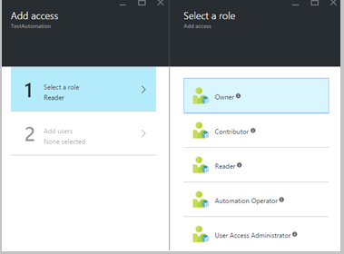
Security
Role based Access management capabilities to segregate duties
At the Automation Account level
Roles:
Owner
Contributor
Reader
Automation operator
User access administrator
Note: access is Inherited for service administrators and co-admins of a subscription and it’s Assigned for all the other users.
Notes:
Info:
https://azure.microsoft.com/en-us/documentation/articles/automation-role-based-access-control/
https://azure.microsoft.com/en-us/documentation/articles/role-based-access-built-in-roles/#automation-operator
Owner
The owner role allows access to all resources and actions within an Automation account including providing access to other users, groups and applications to manage the Automation account.
Contributor
The contributor role allows you to manage everything except modifying other user’s access permissions to an Automation account.
Reader
The reader role allows you to view all the resources in an Automation account but cannot make any changes.
Automation operator
The Automation operator role allows you to perform operational tasks such as start, stop, suspend, resume and schedule jobs. This role is helpful if you want to protect your Automation Account resources like credentials assets and runbooks from being viewed or modified but still allow members of your organization to execute these runbooks.
User access administrator
The user acess administrator role allows you to manage user access to Azure Automation accounts.
NOTE:
Subscription admins already exists as the default user. The subscription admins active directory group includes the service administrator(s) and co-administrator(s) for your Azure subscription. The Service admin is the owner of your Azure subscription and its resources, and will have the owner role inherited for the automation accounts too. This means that the access is Inherited for service administrators and co-admins of a subscription and it’s Assigned for all the other users. Click Subscription admins to view more details about their permissions.
RBAC can be managed from the portal and from PowerShell!

Slide 13
Configuration management
Azure automation DSC
Is a DSC pull server as a service
Deploy, update and monitor the desired state
Can manage any VM (Windows, Linux) in any location (Azure,AWS, on-prem,..)
Builds on top of PowerShell DSC (desired state configuration
More on DSC in a follow up session (4/4/2016)
Onboarding in OMS: Configuration Management with Azure Automation
Notes:
https://azure.microsoft.com/en-us/documentation/articles/automation-dsc-overview/

Slide 14
Q&A

